Slide 1
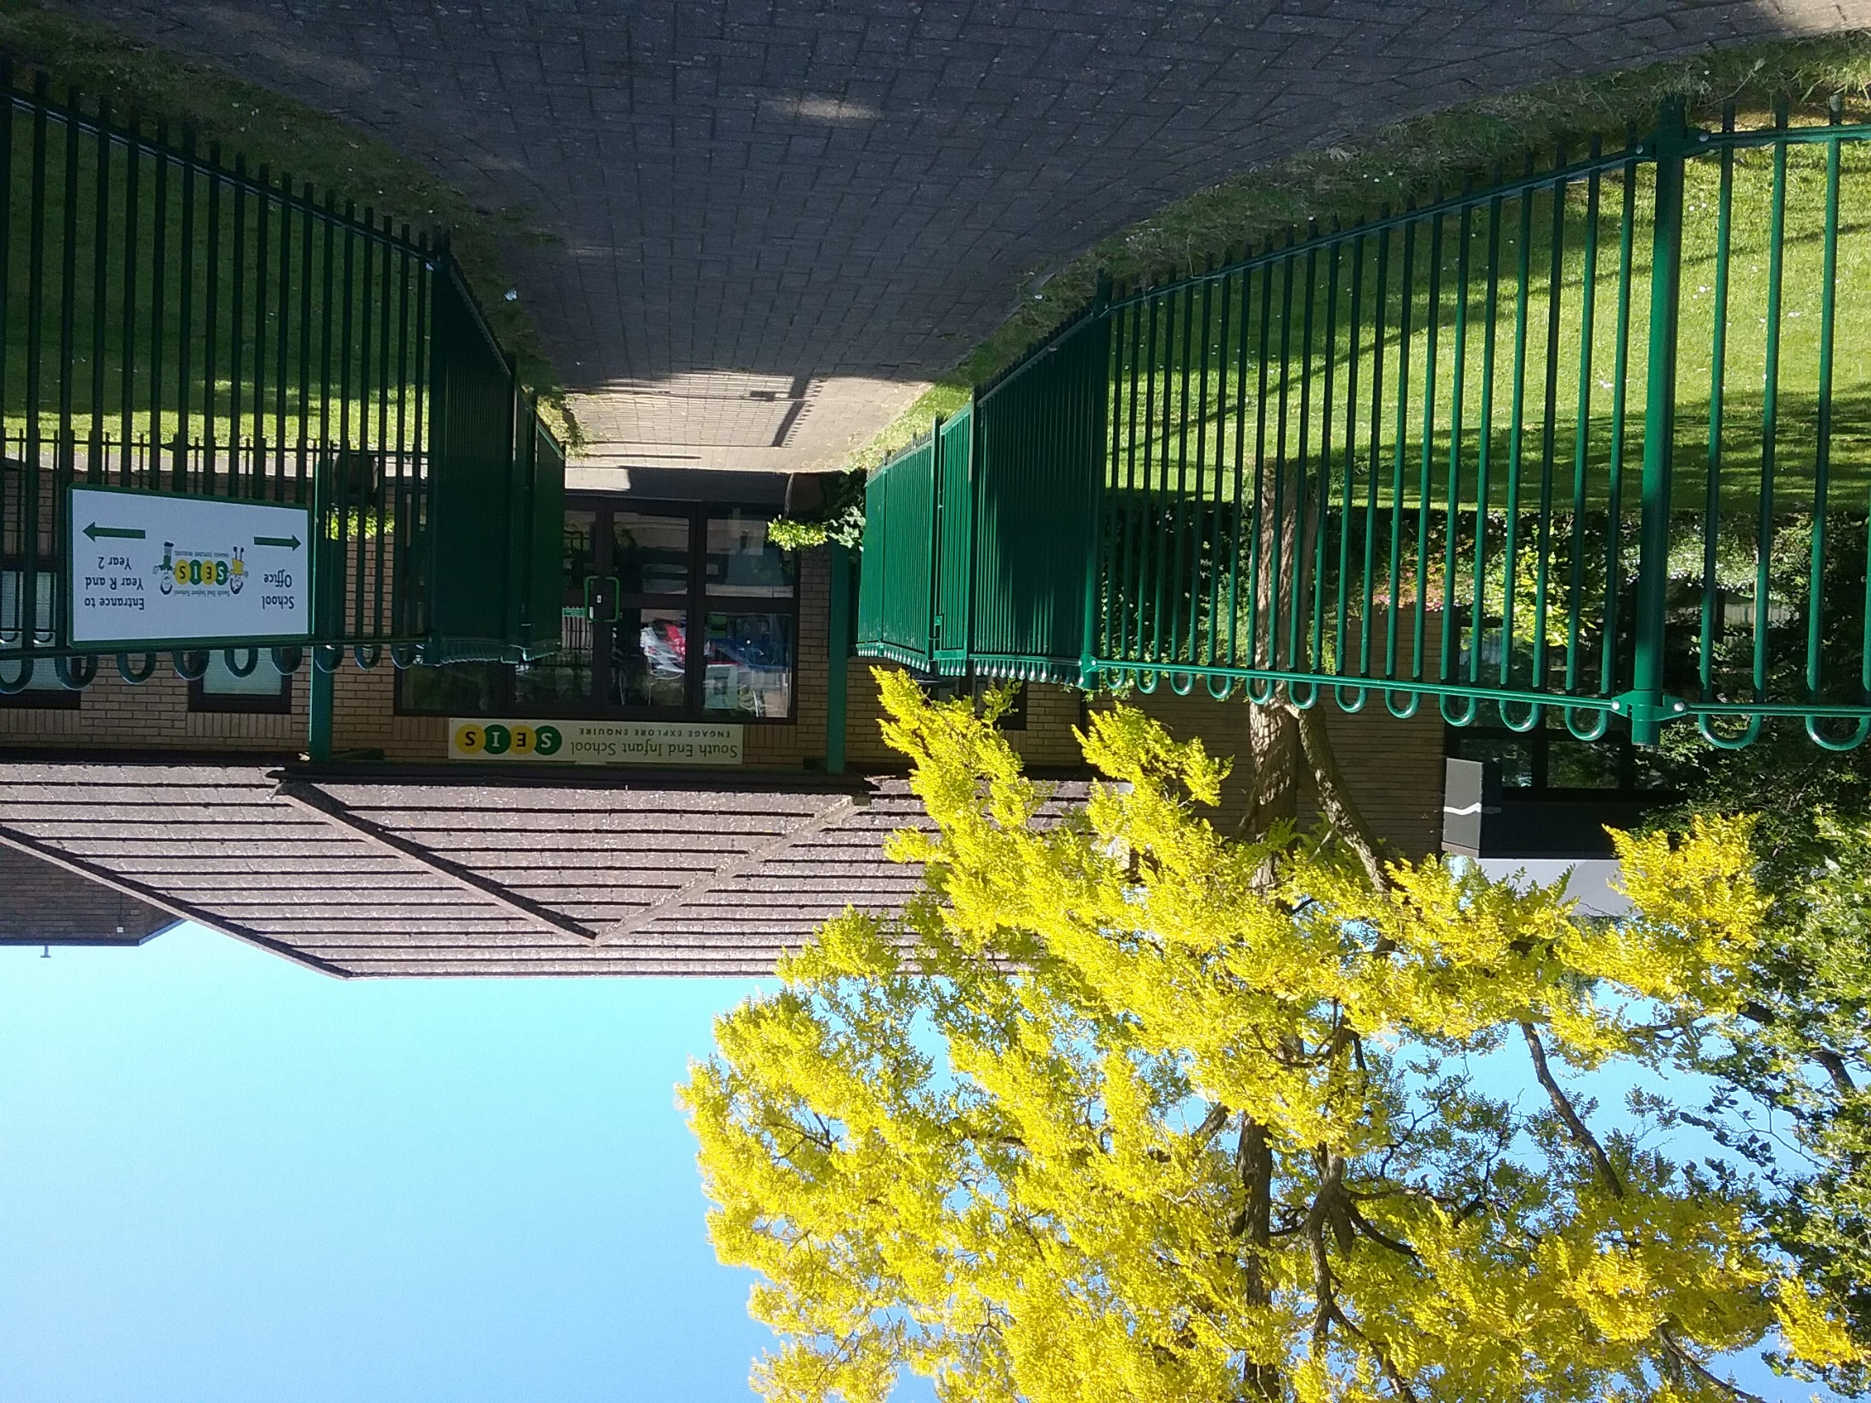
SOUTH END INFANT SCHOOL
ENGAGE, EXPLORE, ENQUIRE

Slide 2
SOUTH END INFANT SCHOOL
ENGAGE, EXPLORE, ENQUIRE

Slide 3
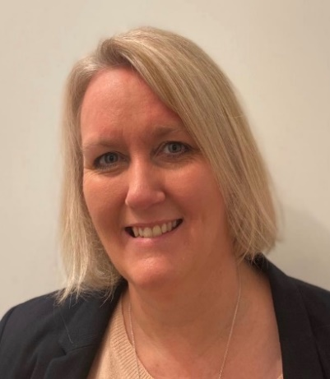
Welcome to South End Infant School
On behalf of the Children, Staff and Governors - Welcome to South End Infant School!
I am extremely proud to be the Head teacher of this welcoming and happy Infant School where we work together with our families to give every child the best possible start to their school life.
We want our children to be excited to come to school each day, to work hard, enjoy learning and develop a sense of pride in themselves and their achievements. At our school, we strive to inspire and enable children to develop socially, emotionally, physically and academically so that they are able to approach new experiences with the confidence that, whatever their capabilities, they will succeed and will become the very best that they can be.
Our children are encouraged to respect and value themselves and others and our curriculum is purposefully designed to secure the skills they need for later life with a very strong focus on the basic skills of English and Maths whilst also promoting our school ambition to enable all children to Engage, Explore, Enquire.
We are all very proud to be part of the SEIS community and the achievements of our wonderful children and staff. We hope that our School website and this prospectus gives you a sense of what our school is like, but if you have further questions, please feel free to contact our school office directly.
Kind regards,
Mrs Elaine Ashcroft
Head Teacher

Slide 4

Vision and Values
SEIS Vision Statement
“To be a community that embraces and inspires each individual to become the best that they can be
in a happy, safe and inclusive environment.”
A place where relationships are strong and children’s voices are heard
SEIS aims
To be a place where:
children are provided with inspiring educational experiences that lead to outstanding outcomes
children feel valued and develop curiosity, resilience and pride
there is a genuine partnership with families
children learn the skills and knowledge that enable them to:
Engage, Explore, Enquire

Slide 5
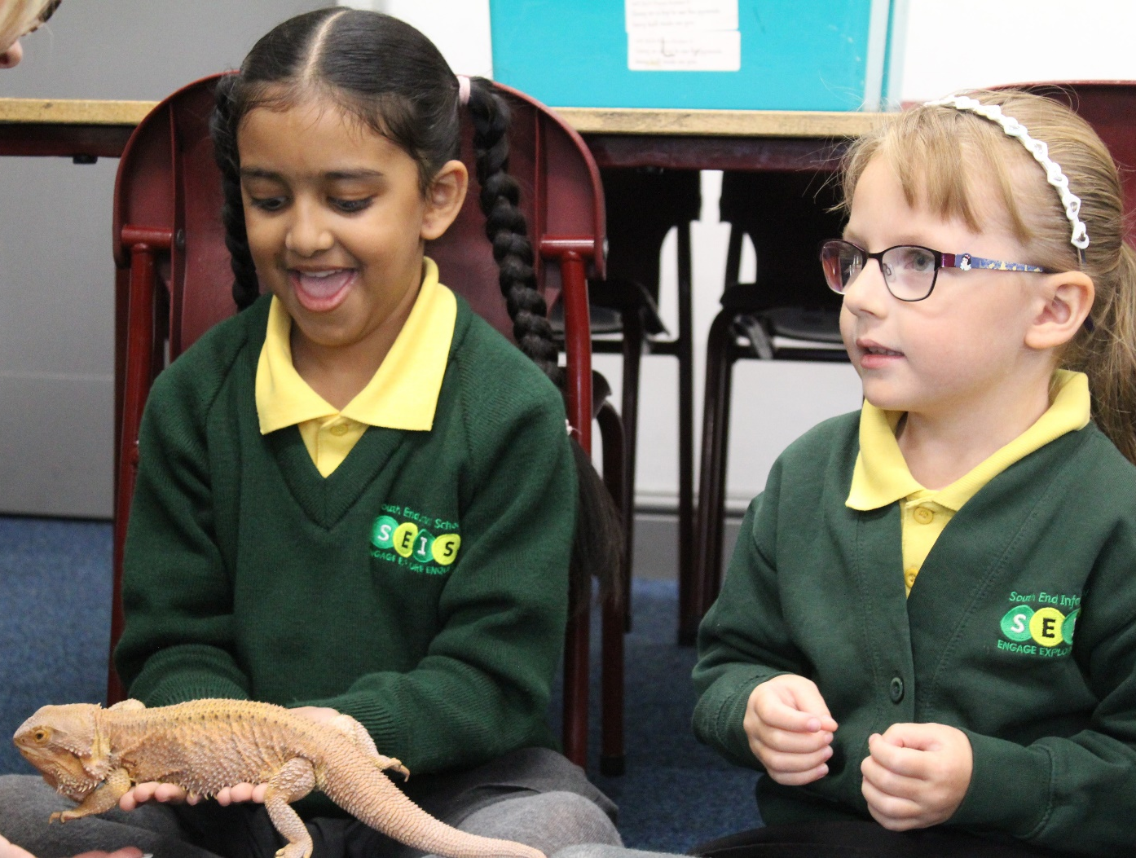
A Typical School Day
School starts at 8:50am and we ask that parents/carers are ready to see their children into the classrooms through each individual classroom door.
Mid-morning Snacks and Drinks
We participate in the National School Fruit Scheme, whereby every child is provided with a free piece of fruit daily before morning playtime, children under five are also entitled to free daily milk. All children have access to drinking water at any time.
Lunchtime at School - 12:00pm to 1:00pm
Children have the option to go bring a packed lunch in a packed lunch box or, under the current DfE regulations, are entitled to have a free hot meal or packed lunch from our provider Kingswood Catering. Every class has their own Midday Supervisor who looks after the children during their lunchtime.
Packed lunch boxes are stored in the children’s classrooms on trolleys, so parents need to bear this in mind when the weather is warmer. Some parents choose to put a little freezer block next to the sandwiches. Packed lunch boxes should be labelled clearly on the outside with your child’s name and class.
The school day ends at 3:10pm – parents/carers can collect their child from the classroom door.

Slide 6
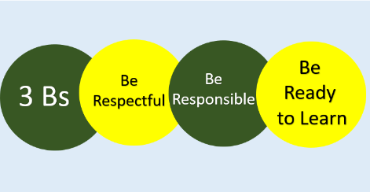
Inclusion, Equality & Behaviour
At South End Infant School we believe passionately in the importance of inclusion and equality for all children and adults, and strive to ensure these values are at the heart of our practices.
Inclusion
South End is an inclusive school where we focus on the well-being and progress of every child. We have high expectations of all our children. To ensure they are able to achieve in all areas, we engage a range of strategies to issue challenges at an appropriate level, and provide support and scaffolding to overcome challenges to learning. Children with special educational needs are supported within their own class, teaching may be adapted to meet every child's needs. Where appropriate and in addition, enhanced in class support may be put in place to meet the needs of children with an EHCP. Similarly, children who are assessed as more able, demonstrating a particular aptitude in a curriculum area, will be given the opportunity to extend their learning in class. All children have equal access to the curriculum.
Equality
At South End we are committed to valuing diversity, tackling discrimination, promoting equality and fostering good relationships between people. We aim to provide an education that promotes awareness, understanding and respect for diversity in our world. This is achieved through the acknowledgement of special days and festivals and the embedding of lessons learned through the achievements of individuals from diverse backgrounds across disciplines and through history.
Our ‘3Bs’ Behaviour Curriculum is taught throughout the school to actively promote the behaviours we want to see every day:
In addition, we reward behaviours that reflect our six values:
Respect, Pride, Aspiration, Courage,
Independence & Perseverance
For younger children, the principles of the rules are simplified to the following statement:
‘Kind hands, kind feet, kind words.’

Slide 7

Joining South End Infant School
Children are accepted into this school in the September prior to their 5th birthday. The cut-off date is 31st August and any child who turns five in the September, enters school the following year.
South End Infant School is a co-educational school for children in educational year groups Reception to two, (age range 4 – 7). The school operates on a planned admission limit system as laid down by Northamptonshire County Council. The Local Authority has formal responsibility for admitting pupils up to the school’s physical capacity, which is ninety pupils in each year group (270 pupils in total).
The governors wish this school to serve the parents and children of the surrounding locality, and it is their intention to provide the highest quality of education possible for this community. As an infant school we work within the limits of infant class sizes, which are capped at thirty.
Application Process
You must fill in an application form through the NNCC website: https://www.northnorthants.gov.uk/primary-school-places/apply-primary-school-place.
Further information to help with the application process can be found in the NNCC document:
https://cms.northnorthants.gov.uk/media/10524/download
10th September – Application portal opens for Primary, Infant and Junior School applications. Information on how to apply for a school place is published by the County Council on their website: https://www.northnorthants.gov.uk/school-admissions.
If you have any questions, please do not hesitate to contact us either via our email contactus@southendinfant.com or alternatively call the school Office on 01933 356571, where we will be happy to help.

Slide 8
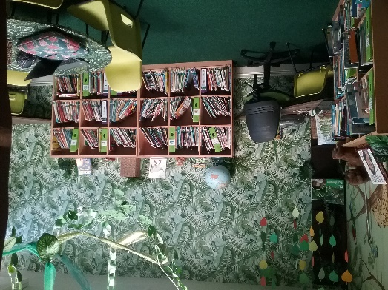
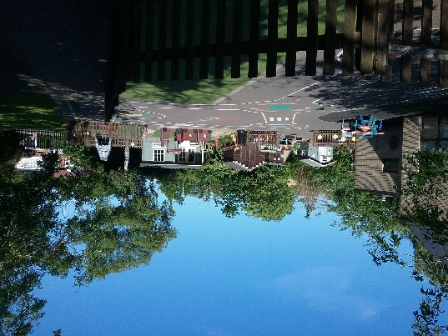


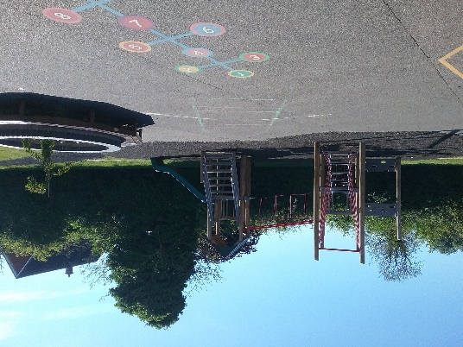
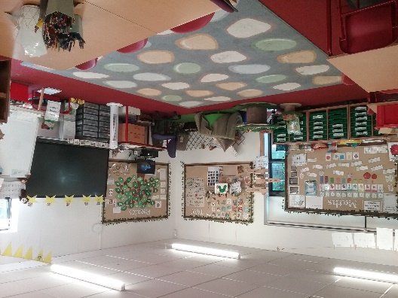
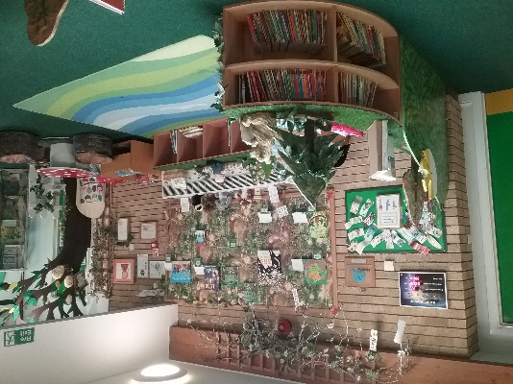
Contact Details
South End Infant School
Wymington Road
Rushden
Northants
NN10 9JU
 01933 356571
 contactus@southendinfant.com
☑ www.southendinfant.com

